Slide 1
Reimagining child protection: thinking differently about families, communities and thresholds
Professor Kate Morris: University of Sheffield
Angela Frazer-Wicks: Parent and FRG Trustee

Slide 2
The studies
Child welfare inequalities
http://www.nuffieldfoundation.org/inequalities-child-welfare-intervention-rates
Stepping up, stepping down:
https://www.frg.org.uk/involving-families/your-family-your-voice

Slide 3
The context for ‘thresholds’
Child protection raises complex moral and political issues which have no one right technical solution. Practitioners are asked to solve problems everyday that philosophers have argued about the last two thousand years… Moral evaluations can and must be made if children’s lives and wellbeing are to be secured. What matters is that we should not disguise this and pretend it is all a matter of finding better checklists or new models of psychopathology- technical fixes when the proper decision is a decision about what constitutes a good society (Dingwall et al, 1983, p. 244)

Slide 4
Notes:
But the dominant factor for explaining any individual child’s chances of an expensive heavy end intervention is the socio-economic circumstances of the family, measured here by the deprivation level of the small neighbourhoods in which the families were living.
11 x higher in most deprived 10% of neighbourhoods.
Almost identical pattern seen for CPP rates.

Slide 5
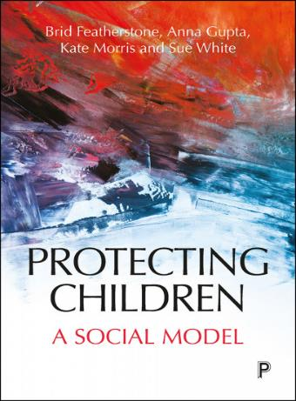
Thinking differently – contributions to a conversation:

Slide 6
Angela Frazer-Wicks Parent, Birth Parent Co-Chair Your Family Your Voice Alliance Trustee Family Rights Group Twitter @AFrazerWicks

