Slide 1
The Association of Directors of Children’s Services Ltd
Pressures in children’s services and what’s driving increased demand
Stuart Gallimore, ADCS President 2018/19,
DCS, East Sussex County Council

Slide 2
The Association of Directors of Children’s Services Ltd
Safeguarding pressures
A decade of evidence
In November 2018, ADCS published phase 6 of our Safeguarding Pressures research.
This longitudinal research had provided evidence of changes in demand for early help, social care and other
services using LA data from 31 March 2008 – 31 March 2018.
It evidences that in the past decade demand has increased, whilst funding has diminished. In phase 6 we also projected what demand pressures might be to 2023.

Slide 3
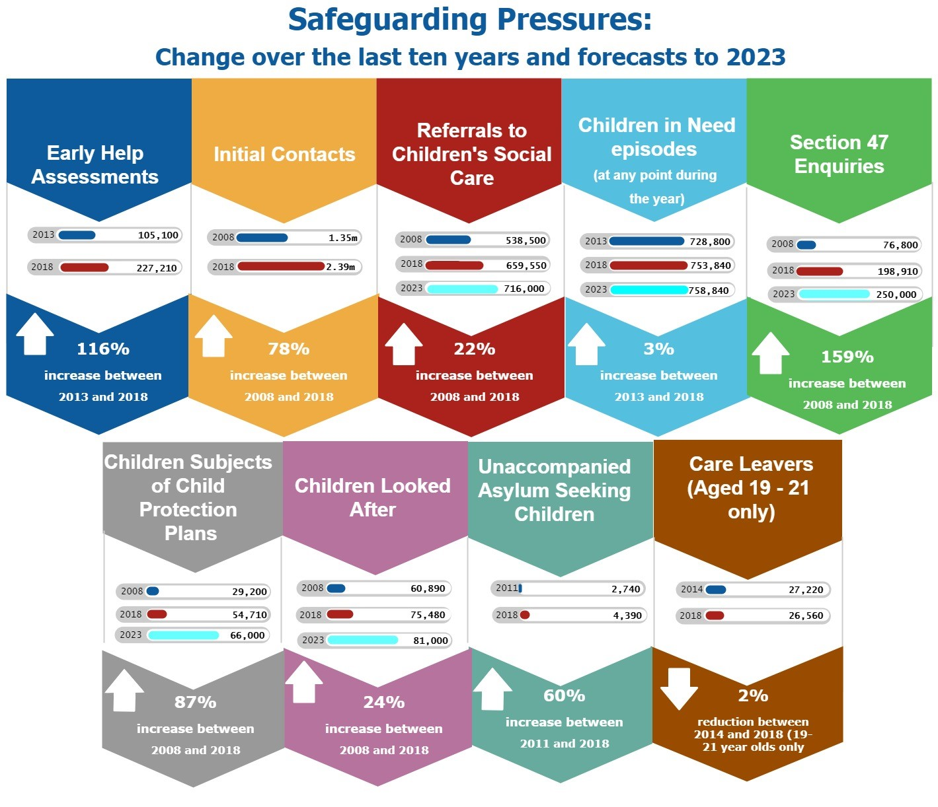

Slide 4
The Association of Directors of Children’s Services Ltd
Evidencing increased demand & reduced resources
It’s not only ADCS making the case.
We triangulated demand pressures as evidenced by local authorities with a significant amount of other published research and evidence, as we can see on the next slide

Slide 5
The Association of Directors of Children’s Services Ltd

Slide 6
The Association of Directors of Children’s Services Ltd
What’s driving increased demand?
More
children
Impact of poverty and wider social determinants
Trigger trio
Contextual safeguarding
Ripple effect from other organisation and public sector areas such as schools and health
Legislation
Funding

Slide 7
The Association of Directors of Children’s Services Ltd
The funding challenge: top four funding pressures for children’s services
Placement costs for children looked after
SEND and High Needs Block
High number of families ‘tipping over’ from early help into social care due to the cumulative impact of welfare reforms, insecure work, lack of affordable housing.
Continued spend by LAs on expensive agency social workers.

Slide 8
The Association of Directors of Children’s Services Ltd
What is the quantum of the funding gap?
From ADCS Safeguarding Pressures research: £840m each year, before inflation, is required simply to “steady the ship” (assuming no growth in demand and no increase in costs)
From LGA: original estimate of a £2b shortfall by 2020. Updates estimate of £3b shortfall by 2025
From Isos (commissioned by LGA) on High Needs Block overspend: by 31 March 2019, national deficit on HNB c.£470m

Slide 9
The Association of Directors of Children’s Services Ltd
What can be done to address the funding gap?
A sustainable funding settlement for all LAs – move away from the short termist, ring-fenced pots of money for which LAs must bid. Funding must be linked to need, not the skill of the bid-writer
Spending Review: are children’s services being held to a tougher test when asked to ‘prove the case’ for more investment?
Continuation of ‘Troubled Families’ funding – in many LAs, it’s this funding alone that is propping up early help services

Slide 10
The Association of Directors of Children’s Services Ltd
What else could be done to address the funding gap?
Removing the profit element from IFA placements, independent children’s homes, the independent and non-maintained special school sector, and capping agency social worker rates
Reform the SEND reforms – we cannot buy our way out of HNB overspends
Review structural constraints – setting annual budgets for demand-led services inhibits the LA’s ability to manage demand

Slide 11
The Association of Directors of Children’s Services Ltd
Conclusion
Devastating budget cuts have seen LAs dipping into their reserves and/or diverting funds from other services to protect children’s social care. But, a tipping point has been reached
Children’s services cannot become a ‘blue light’ service yet without significant government investment LAs will be forced to make counter-intuitive cuts.
LA children’s services must be resources to allow for a focus on prevention. Change of this magnitude takes time…longer than a Parliamentary cycle

