Slide 1
Medical Evidence in Child Abuse Cases How research papers inform expert evidence: Systematic Reviews
Dr Jo Gifford
RCPCH Expert Lead for Child Sexual Abuse
Project co-Lead for CSA Systematic Review
Expert Reviewer for Physical & Neglect
Designated Doctor Child Safeguarding, Coventry and Warwickshire
Consultant Community Paediatrician, Coventry and Warwickshire Partnership Trust

Slide 2
This talk won’t
be a list of key messages from the RCPCH Child Protection systematic reviews
Massive topic….
Itty bitty time slot!

Slide 3
Understanding your Medical Witness:
How ‘Expert’ is your Expert?
How do doctors think?
What do doctors mean by ‘evidence’?
Evidence Based Medicine (EBM)
Systematic Review Process
RCPCH Systematic Reviews
Evidence-based Medicine in Court
The use and misuse of medical evidence
Standardizing terminology around interpretation
This talk will cover…

Slide 4
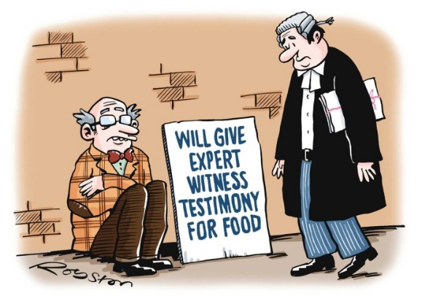
Medical Evidence
Professional Witness
Treating Doctor, NHS core role
Unscheduled Child Protection Medical Assessment
Child already known to doctor
Planned Child Protection Assessment
Expert Witness
Notes/bundle based opinion
Extra to ‘Day Job’
professional Experts
Subject Experts should know the evidence-base

Slide 5
Who is this Doctor?
Foundation years
Foundation F1 F2
‘House jobs’
Specialty training
Run-through training
Senior Doctor
Consultant
+/- subspecialty
ST 1-8
‘SHOs & Registrars’
Forensic medical examiner (self employed)
Exams/selection
General Practice
Exams/CCT
Specialty Doctor

Slide 6
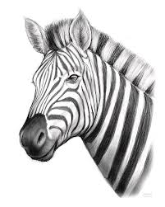
How doctors think…
Pattern recognition to identify the clinical sign
The differential diagnosis
Collective signs + symptoms + history +/- test results
Probability
‘Think horses not zebras’
‘Never say never’
Look for the common, the treatable, and the must-not-miss
Physical findings are clinical signs
signs form part of a clinical picture; the overall picture gives the order of the differential diagnosis

Slide 7
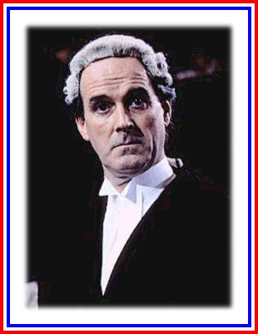
“Evidence” means….

Slide 8
What doctors mean by evidence…
But clinical experience and orthodox teaching in medicine also have a large role in pattern-recognition and formation of differential diagnosis

Slide 9
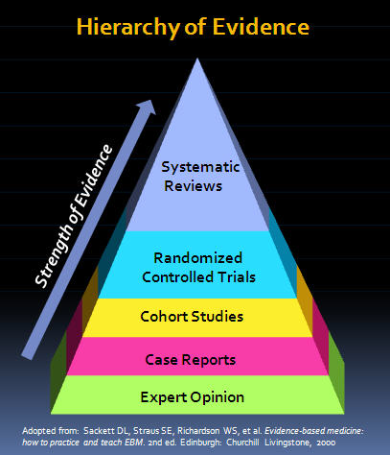
Evidence-Based Medicine
Evidence-Based Medicine” (EBM) refers specifically to the conscientious, explicit, judicious and reasonable use of modern best research evidence in decision-making about the care of individuals. Its principles are by extension applied to the interpretation of clinical findings.

Slide 10
Not all studies are created equal…
Critical appraisal is an established academic method of evaluation the strengths and weaknesses of a particular published paper. It is the process of carefully and systematically examining research to judge its trustworthiness, and its value and relevance in a particular context.
Peer Reviewed Journal
Study aims & design
Study inclusion/exclusion criteria, confounders, bias
Cohort size(s)
Conclusion in respect of results

Slide 11
Case series
Report on a series of patients with a condition, intervention or outcome of interest. No control group involved.
Case study
Uncontrolled observational study involving an intervention and outcome for a single person.
Case control
Patients who have the outcome of interest (cases) and control patients who do not have that same outcome and looking back to see if they had the exposure of interest.
[Randomised controlled trial]
two groups - the intervention group,, and the comparison or control group, receiving an alternative placebo intervention or none at all.
What kind of study is this?
Cross-sectional uncontrolled before and after study
cohort in specific time window - both outcome and exposure are screened for simultaneously.
Prospective cohort/longitudinal
Assembles participants and follows them into the future.
Retrospective cohort study
identifies subjects from past records and follows them from the time of those records to the present.
Interrupted time series
Time series of a particular outcome of interest is used to establish an underlying trend, which is 'interrupted' by an intervention at a known point in time.
When ‘intervention’ = abuse…there are no randomised control trials!

Slide 12
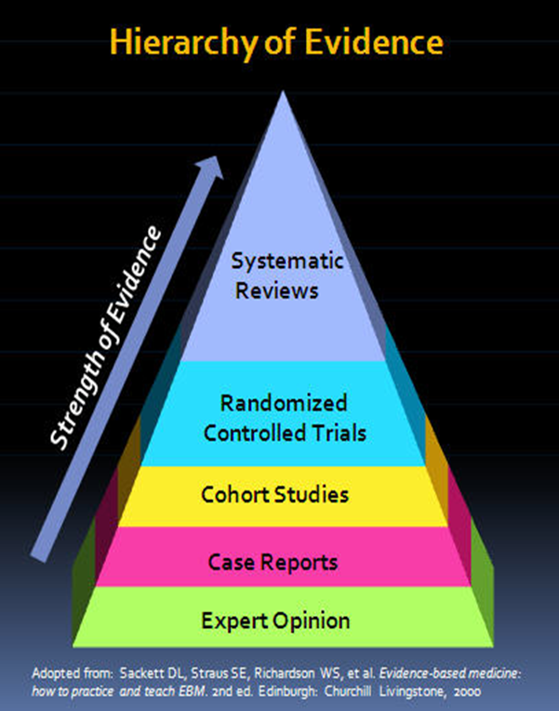
What is a systematic review?
A systematic review gathers together all available empirical research by using clearly defined, systemic methods to obtain answers to a specific question or questions.
RCPCH methodology
Clinical questions set
Key word search of databases
2 reviewers per paper →3rd
Exclusion and inclusion criteria
Data extraction
Questions answered based on all available evidence

Slide 13
Evidence-base in Physical Abuse & Neglect
RCPCH Systematic Review of Child Protection Evidence:
Bites
Bruising
Burns
Dental neglect
Ear, nose and throat
Early years neglect
Fractures
Neurological injuries
Oral injuries
Parent-child interaction
Retinal findings
School-aged neglect
Spinal injuries
Teenage neglect
Visceral injuries
https://www.rcpch.ac.uk/key-topics/child-protection/evidence-reviews

Slide 14
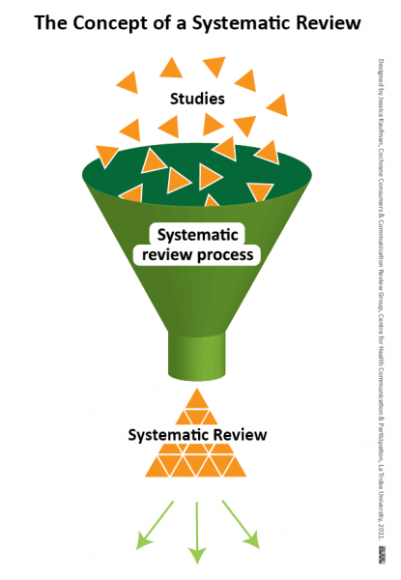
RCPCH Systematic Review of Child Protection Evidence
Rolling programme of updates
Publications Lead
Publications sub-committee
Expert Reviewers
Open access
Key messages → Child Protection Companion

Slide 15
Evidence-base in Child Sexual Abuse
3rd Edition 2023

Slide 16
3rd Edition Purple Book Project structure
Project Board:
CSA Clinical Co-leads:
Michelle Cutland & Jo Gifford
Stakeholder organisation reps:
Sheila Paul (FFLM), Karen Rogstad (RCP), Kim Bond (NAPAC), Cindy Christian (AAP), Alice Johnson (RACP).
Chapter leads (x9)
Chair: Cath White
RCPCH Research Team:
Nish Talawila (Evidence synthesis manager)
Lily Pembroke (Systematic reviewer)
Onubha Hoque Syed (Administrator)
Stakeholders:
Various
Oral signs of child sexual abuse:
Muriel Volpellier & Roisin Begley
Chapter working groups
Genital signs of sexual abuse in girls:
Sheila Paul & Alice Monfrinoli
Anal signs of child sexual abuse:
Wendy Gray & Arlene Boroda
Sexually transmitted infections:
Dawn Wilkinson, Rebecca Thomson-Glover & Rebecca Girardet
Genital bleeding in pre-pubertal girls:
Briony Arrowsmith & Cath White
Genital signs of sexual abuse in boys:
Jamie Carter & Sandra Ives
Anogenital signs of accidental injuries:
Louise Newbury & Ewa Wolska
Healing of anogenital injuries:
Helena Thornton & Lucy Killian
Extent of anogenital signs at examination:
Fiona Pettet & Marianne Cochrane
Expert Reviewers – Blind appraisal of individual papers against agreed criteria

Slide 17
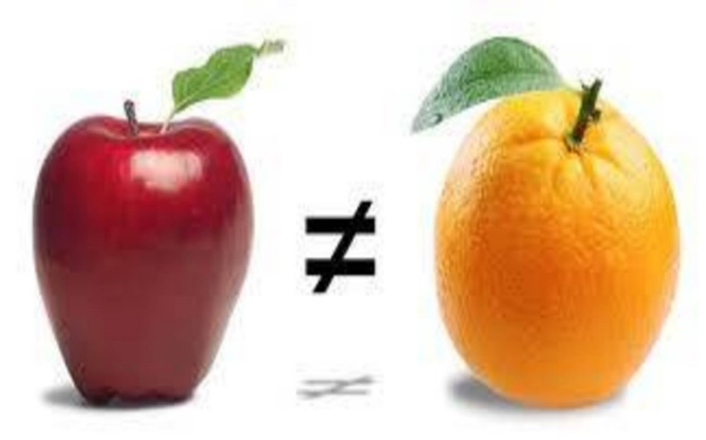
Systematic Review Challenge 1
Are the studies comparing like with like?
Different studies use different
Terminology for signs
age-group inclusion/ exclusion
examination positions
type/definition/timing of abuse
definition of non-abuse

Slide 18
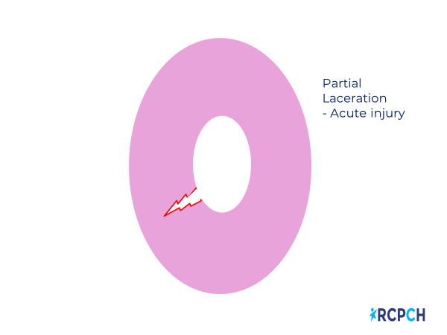
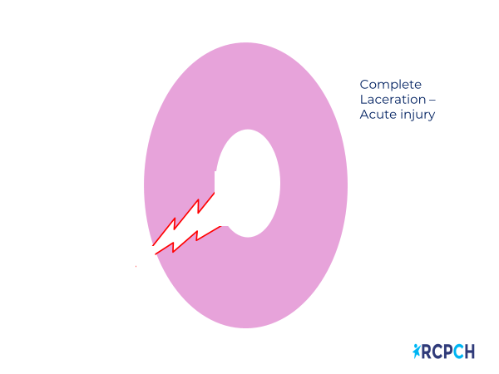
RCPCH Solution 1: Standardise Terminology
Example: hymenal signs standardised by 2nd Ed purple book

Slide 19
Purple Book Terminology 1st → 2nd Ed
Reflex anal dilatation
Anal gaping
Anal laxity
Anal Fissures
Attenuation of hymen
Complete cleft
Dynamic anal dilation (external/total)
Static anal dilation
(external/total)
Anal Laceration
Narrow hymen

Slide 20
Systematic Review Challenge 2
How is abuse confirmed in the “case” cohorts, and excluded in the “control” cohorts?
Paucity of case-control studies
Controls “Non abused”
Ethics of examining “normal” children
Co-factors (cause/effect vs association) eg constipation in CSA

Slide 21
RCPCH Solution 2: Cohort security (abuse/non-abuse) Rankings
Level | Criteria used to define abuse*
1 | CSA confirmed at case conference/family/civil/ or criminal court proceedings or admitted by perpetrator
2 | CSA confirmed by stated criteria including multidisciplinary assessment.
3 | CSA defined by stated criteria
4 | CSA stated but criteria not given.
5 | CSA suspected.
6 | Cannot tell
7 | Cannot confidently include the study but it has some merits
Level | Criteria used to define non-abuse*
1 | Newborns or children screened to exclude sexual abuse with a review of past medical records to identify any previous concerns relating to CSA and a structured parent interview and/or a child interview for verbal children.
2 | Children referred into clinical services for reasons other than suspected CSA or genitourinary complaints where CSA was not actively excluded.
3 | Children presenting with genitourinary complaints.
4 | Non-abuse stated and no further details given.

Slide 22
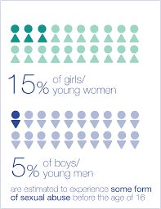
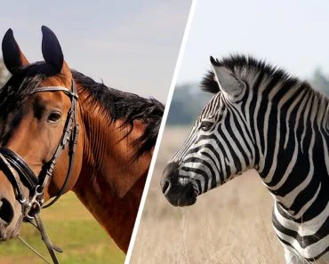
EBM informing and supporting Medical Opinion
Evidence Statement
Hymenal lacerations were not seen in girls selected for non-abuse
[they] were seen in 33% of prepubertal girls with a history of vaginal penetration

Slide 23
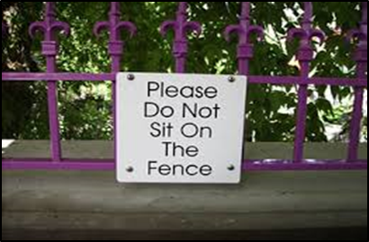
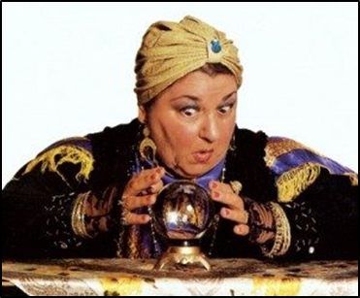
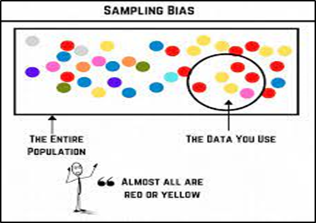
Unhelpful medical evidence (testimony) & misuse of EBM
Abstains from any opinion
Ignores evidence
Sitting on the fence where evidence exists
If injury seen would you take safeguarding action?
‘psychic certainty’ and unfounded theories
Over-stretching possibilities of plausibility
Over-reaching the boundaries of EBM
Nothing is impossible…but what is likely?
Based in Bias
Selective use of single papers
Failure to consider other possibilities
Mis-interpreting of results

Slide 24
Study A
Aim: to determine what the physical characteristics of Jurors.
The cohort: the Jury in Court Case X.
Results:
one Juror had green eyes (not defined in the published study methodology).
no Juror with red hair (not defined) was found.
Only one of the 12 was wearing pink (not defined) during the study period, which included daily follow up over a 12 week period, and that they did so on 35 of the days of trial attendance.

Slide 25
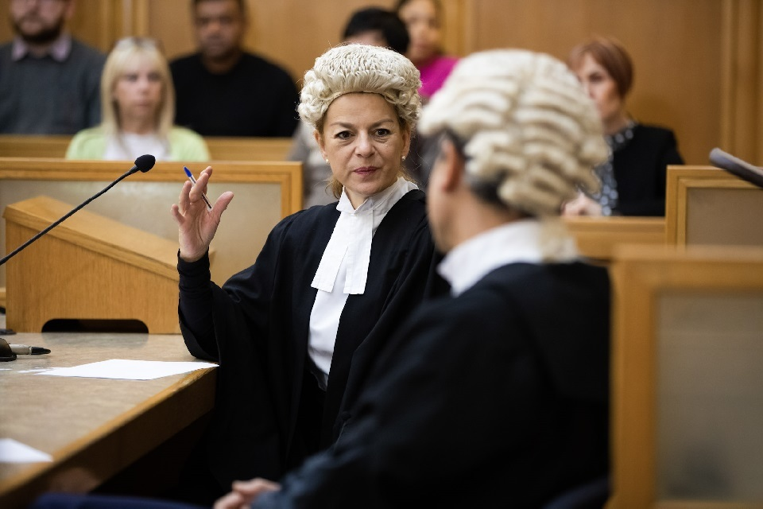
Study B
Aim: to describe the physical characteristics of individuals involved in the Criminal Justice System.
Cohorts: Jurors and Legal Professionals across two trials, Y and Z.
Results: Legal Professionals were significantly more likely to wear black in Court than the cohort of Jurors (99% and 4% of ‘person-days’ respectively).
No individuals with red hair were described in any of the cohorts in this study, but one person with “auburn-brown” hair was found in the cohort of Jurors from trial Z. In addition, one Legal Professional in Court Z changed hair colour from “strawberry blond” to “ash gray” during the course of the study period.

Slide 26
What We CAN Say from studies A&B collectively
Key message:
Other reasonable interpretations:
That a range of physical characteristics are described in Jurors, based on two studies.
Further information on the prevalence of physical characteristics in the general population is required to say whether or not any characteristic is more likely to occur in Jurors than in the general population or to infer any possible jury selection bias.
That evidence from a single small scale [B] study suggests that Legal Professionals are more likely to wear black in court than Jurors.
That “red” hair has not been documented in a Juror in either study, although the description of “auburn-brown hair” may be considered suggestive of red hair by some authors of other studies, and not define by the study B authors.
That green eyes have been described in a cohort of jurors [A]. This suggest they can occur in Jurors, however the sign was not defined by the study authors.

Slide 27
What We CAN’T Say from studies A&B collectively
That red hair in jurors cannot occur…or that red hair is not physically possible.
That study B shows Jurors do not wear black.
Any statistical analysis about the wearing of pink in relation to any cohort, or wider population.
That green eyes can only occur in Jurors and not in Legal Professionals.
“Heger 2003 shows the hymen cannot scar”

Slide 28
It’s often in the history…
I was in a fight
I was hit by a cricket ball
I fell into someone’s elbow in a rugby scrum
I fell down the stairs
I did an emergency stop and hit the steering wheel
I woke up like this
Medical opinion will often be relative to the story/stories if offered:
“Likely”… “Suggestive of”…”Plausible”… “Consistent with”…”Possible”… “On balance”…
Pattern recognition + experience of how tissues behave + EBM

Slide 29
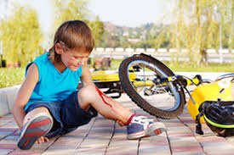
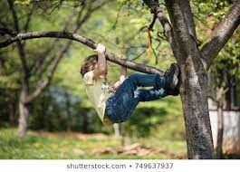
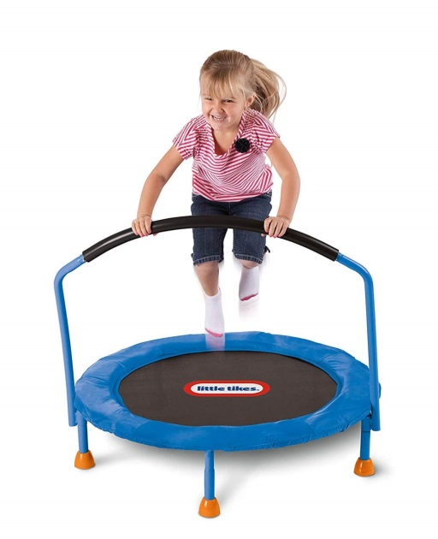
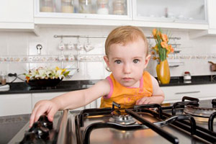
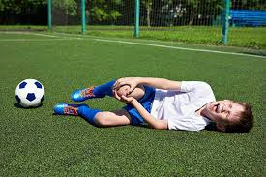
Normal childhood: injury risk

Slide 30
Accidental Injury in Normal Childhood
More force (speed/height) = more injury
bad injury = memorable
younger child = more supervision
Mobile toddler
Trampolining 8 year old
Skateboarding teen
EMB:
It is unusual to have more than 4 minor bruises at any one time in active, mobile children, without explanation.
Accidental injuries most likely on extensor surfaces

Slide 31
Injuries of safeguarding concern
Informed by EBM
“Characteristic” of inflicted injuries
“Suggestive” - suspicious features about the injury
“Non-specific” injury but no/suspicious explanations
Injuries that are probably accidental but neglect is a factor
Slap marks, belt marks, cigarette burns, patterns
Less common
Clusters, protected locations, numerous/ extensive or frequent
Inconstant story, unexplained finding, allegation that inflicted
Sibling/animal inflicted, domestic accidents.
common

Slide 32
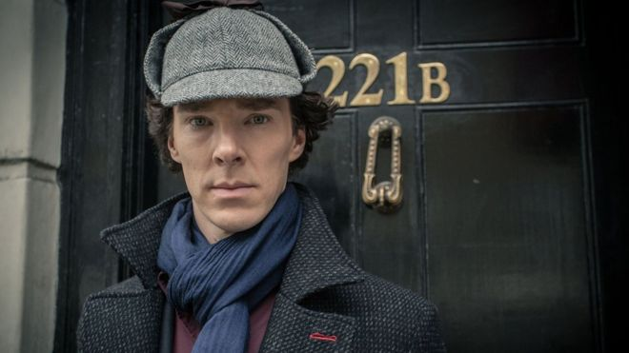
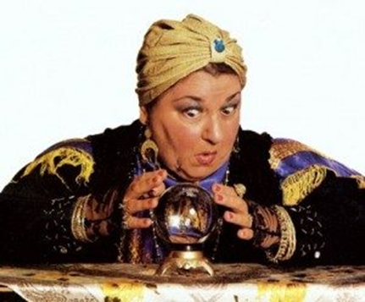
Limits of Medical Evidence
Doctors can usually say
What the injuries are
How a particular finding is likely or most likely to have been caused(knowledge of how tissues behave)
Doctors can’t usually say
Who did it
Exactly when it happened
Why - If the intension was malicious (usually)

Slide 33
Systematic Reviews→ Standardising terminology on interpretation
3rd Edition

Slide 34
1. Interpretation of Findings in isolation
Safeguarding action
Suggestive/
indicative of abuse
Neutral
Neutral (includes normal)
Suggestive/
indicative of organic process
No safeguarding action
Examples:
Laceration to hymen→
In isolation indicative of penetrative trauma.
Multiple well-defined linear bruises to back →
Suggestive of inflicted injury in isolation

Slide 35
2. Interpretation of Findings in relation to allegation
Actively adds weight
Supportive
Suggestive or non-specific finding +
Compatible allegation
Consistent with
Neutral – does not assist either way
Inconsistent
Makes explanation unlikely
Examples:
Bruises to shins →
In isolation likely to be accidental injuries.
Consistent with allegation of being kicked in shins
Bruise to the ear→
Suggestive of inflicted injury in isolation
Consistent with history of exceptional accidental injury

Slide 36
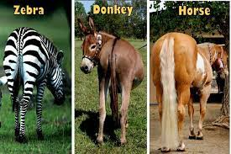
Take Home Messages
Medical Experts should give Evidence-Based Opinions
Systematic Review provides a much higher standard of evidence than single papers.
The RCPCH has published Systematic Reviews in
Neglect
Physical Abuse
Child Sexual Abuse
The Expert should make clear the basis for their opinion, the limitations of the published evidence, and the range of possible interpretations

Slide 37
Any Questions?
Invitation to Cross examination

Slide 38
Thank you!

