Slide 1
Best evidence from psychologist experts: Lessons from recent cases – or when is a psychologist not a psychologist?
Dr Jaime Craig
Consultant Clinical Psychologist
FJC Child Mental Health Specialist Member

Slide 2
The value of expert Psychological evidence
Well timed, high quality psychological evidence should save time and money, and crucially lead to better outcomes.
Key issues:
  Capacity
  ‘Treatability’ capacity for change / timescales
  Are the interventions / plans being suggested likely to be effective / lead to necessary change / good outcomes?
Private and Public law

Slide 3
making the case…
In the absence of a psychologist expert, ‘psychological’ evidence and opinions will continue to be offered in court by non-psychologists and impact on decisions.
With increased complexity comes increased risk of error
Complimenting the skills of social workers / children’s guardians / therapists
Reliable assessment methodology, standardisation, evidence-based – not one therapeutic framework (psychotherapists), synthesis of information ‘triangulation’
Notes:
jaime

Slide 4
What level of training do we expect in other areas of psychology practice?
NHS
  Clinical Psychologists
  Counselling Psychologist
  Forensic Psychologists
  Health Psychologists
Education
  Educational Psychologists
  Clinical Psychologists
  Counselling Psychologists
N.B. Public protection not Profession protection

Slide 5


So what sort of psychologist is needed?
Assessments of?
  Adults
  Children
  Family group / integrated assessments
Practitioner Psychologists
  Educational Psychologists
  Clinical Psychologists
  Counselling Psychologists
  Forensic Psychologists

Slide 6
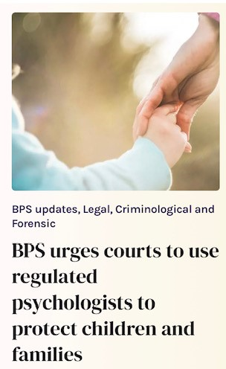

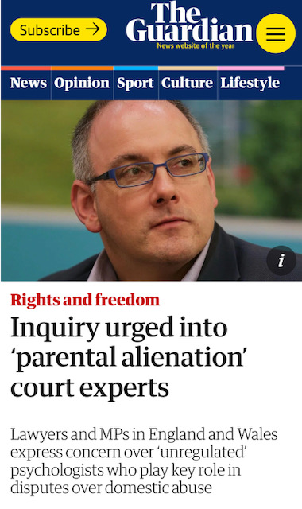
Unregulated ‘psychologist’ Experts
Concerns raised about the credentials of some experts and whether these are sufficiently scrutinised by courts e.g., Hunter et al, 2020; the Association of Clinical Psychologists, the Media…

Slide 7
When is a psychologist expert not a psychologist expert?
F v M (3) (2022) EWFC 89 “need for legal definition”
FJC/BPS 2022 guidance very clear
Academic psychologists ‘chartered with BPS’
Practitioner psychologists ‘HCPC registered’
  ALL others are not psychologist experts
  Other bodies which affiliate / represent / market expert witnesses are not able to accredit or regulate the practice of psychology and should not contradict guidance given by the body for that profession about competence.

Slide 8
The thorny issue of experts in ‘parental alienation cases’
Concerning use of experts as quasi ‘fact finders’ in cases involving allegations of Parental Alienation
The risks of confirmatory bias / a narrow assessment lens

Slide 9
Alienation allegations should not be treated as special cases
Beware conflicts of interest and confirmatory bias (FJC interim guidance in relation to expert witnesses in cases where there are allegations of alienating behaviours - May 22)
Broad psychological assessment by HCPC registered psychologist, not a therapist or ‘alienation expert’, reduces this risk of this
President’s memorandum - Experts in the Family Courts Oct ‘21 ‘…based on an established body of knowledge’
NOT to determine if PA has or hasn’t happened, that is for the court to determine – ‘Alienating behaviours’ / harmful parenting
Realistic prospect of change
Robust assessment driven intervention plan
Balancing of harms in considering options to improve child’s outcomes / not righting wrongs – PD12J

Slide 10


Parental alienation ‘experts’ – unregulated and should not be appointed as psychologist experts
HCPC registered Psychologist experts are the only statutorily regulated psychologist experts in UK
No such thing as a ‘child’ psychologist
Chartered psychologists (a membership grade of BPS - not equivalent – does not tell you their training or skills – non-regulatory – most applicable to academics)
Updated FJC/BPS Guidance 2022

Slide 11
Integrated family psychological assessments
Interacting factors
This parent’s competencies, difficulties & risks with this child’s needs.
Interplay of dynamics of relationships in the family
  E.g. Crucially important in context of allegations of Parental alienation / rejection

Slide 12
Assessment Factors what factors should be considered? – not exhaustive…
Developmental
Environment / Culture
Impact of trauma
Cognitive ability
Mental health
Personality
Parenting experiences
Relationship patterns
Attachment representations
Parental attributions
Meaning of the child
Interpersonal functioning
Impact of substance misuse /alcohol
Offending
Resilience
Support networks
Previous uptake of help

Slide 13
Good reports
Evidence-based / formulation driven opinions
Evidence-based intervention option if there is one
Formulation driven interventions vs diagnostic driven interventions
Set out potential Risks
Bring together multiple factors
Cross-psychological models/theories - applied scientists, not psychotherapists specialising in a particular modality
Systemic framework
Objective, balanced and clear opinions
Offer possible solutions and ways forward that are innovative / realistic
Describe the prospect of success and timescales

Slide 14
Thank you for listening

