Slide 1
Family Justice Strategy for London
Notes:
Introduce yourself
On behalf of the FJYPB I'd like to thank you for inviting us to your event today. I will be sharing with you all some thoughts and messages from our members about delay in the family courts and particularly about the impact of this for us.

Slide 2
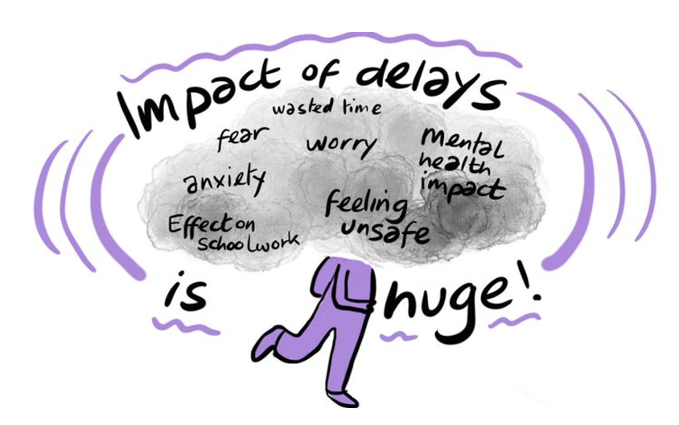
Notes:
Delays in the family courts have a huge impact of the lives of the children and young people and you can see on this slide some of the impact for FJYPB members when they were involved in proceedings such as feeling unsafe, anxious, fearful and can impact on other areas of our lives, such as school.
Delay creates a feeling of uncertainty, not knowing when it will be over and when a decision will be finally made as well as a fear about that final decision and how this might change our lives.
Please remember that what happens in our childhood lasts a lifetime and our experiences from these years, including having decisions delayed for us, will have an impact on how we engage within the adult world, form relationships and on our opportunities and ambitions.

Slide 3
“My passport was withheld for 18 months; I could not leave the country and visit my grandparents. I had to spend time talking to social workers and Cafcass workers instead of playing with my friends.”
“I didn’t really enjoy my childhood knowing everyone around me was worrying all the time.”
“The feeling of uncertainty wasn't helpful as I had to wait for many years for a final outcome. I knew what I wanted, and I believed that the outcome should be obvious, so I was confused as to why the proceedings took so long.”
“It made me worry even more. It made me wonder if something has gone wrong or if nothing is gonna happen and that it will keep getting pushed further and further.”
“The delay in my family court case made me extremely frustrated and anxious. I never knew what to expect. The emotional abuse I received from my mother only got worse and my mental health became out of control. I felt as though it was all my fault.”
“I couldn’t have CAMHS support whilst my proceedings were ongoing. I had a terrible temporary shared care arrangement for every other night for well over a year. I had no routine or certainty.”
“I could not focus in school, I would cry almost every day. I hated those years of my life.”
Notes:
Our members were asked about how the delays in their court proceedings made them feel. Here are some of their comments. (use the clicker to being up each quote as you read it)
“I didn’t really enjoy my childhood knowing everyone around me was worrying all the time.”
“I couldn’t have CAMHS support whilst my proceedings were ongoing. I had a terrible temporary share care arrangement for every other night for well over a year. I had no routine or certainty.”
“The feeling of uncertainty wasn't helpful and as I had to wait for many years for a final outcome. I knew what I wanted and I believed that the outcome should be obvious so I was confused as to why the proceedings took so long.”
“It made me worry even more. It made you wonder if something has gone wrong or if nothing is gonna happen and that it will keep getting pushed further and further.”
“The delay in my family court case made me extremely frustrated and anxious. I never knew what to expect. The emotional abuse I received from my mother only got worse and my mental health became out of control. I felt as though it was all my fault.”
“I could not focus in school, I would cry almost every day. I hated those years of my life.”
“My passport was withheld for 18 as months, I could not leave the country and visit my grandparents. I had to spend time talking to social workers and Cafcass workers instead of playing with my friends.”

Slide 4
…mental health problems come in all shapes and sizes- sometimes very obvious and sometimes not manifesting for years.
The children and families you are involved in now can come out of their proceedings thinking that’s the end of their story, when in reality they may have many difficult chapters ahead.
A child’s court journey doesn’t end after that final hearing, so its everyone’s job to make your time with a child or family as valuable and as worthwhile as possible, however long or short that may be.
Notes:
FJYPB members have also shared what we would like you to think about in relation to our proceedings and you can see some thoughts on the slide now. READ THE QUOTES.
Our message is that for children and young people, proceedings are just one part of our journey. We live with the issues and worries that bring us into proceedings - sometimes for many years - and experiencing delay in the decision-making can add to the harm for us. Whilst the end of proceedings might be when some of you end your involvement with us, our journey continues and we may have some difficult adjustments to make and challenges ahead as a result of the decisions so please be mindful of this in your work with us.

Slide 5
Be open with me about how long my proceedings might take and explain the reasons for any delay with me as well as what you are doing to manage this.
Ask me about how the delay is affecting me and take action to minimise the impact of this - such as keeping me regularly updated and making sure I have good support.
Think about how YOU might contribute to the delays and what you can consider and perhaps challenge on my behalf, such as: is that expert report really going to add value?; are your reports filed on time?; is additional assessment likely to make any difference?; is a 16.4 appointment really necessary?; is the case management in proceedings robust enough?
THINK: Are you putting my needs before the rights of my parent/s?
Notes:
We want to just take this opportunity to ask you today to have these considerations in mind when you are planning and undertaking with and for us: -
1 Be open with me about how long my proceedings might take and explain the reasons for any delay with me as well as what you are doing to manage this.
2 Ask me about how the delay is affecting me and take action to minimise the impact of this - such as keeping me regularly updated and making sure I have good support.
3 Think about how YOU might contribute to the delays and what you can consider and perhaps challenge on my behalf, such as: is that expert report really going to add value?; are your reports filed on time?; is additional assessment likely to make any difference?; is a 16.4 appointment really necessary?; is the case management in proceedings robust enough?
4 THINK: Are you putting my needs before the rights of my parent/s?

Slide 6
we are
RECRUITING
We have an opportunity for more children and young people to join the FJYPB.
We are specifically keen to recruit more members with public law experience.
We will be opening recruitment in early December 2024 and will share with you our recruitment poster.
CLOSING DATE
10th January 2025
Do you have experience of
being supported by your local authority?
living in the care of another family member or foster carer?
being a care leaver?
Do you want to have your voice heard?
Do you want to help make changes?
Do you want to earn money for the work you do?
You can check us out at: www.cafcass/fjypb
Or contact us for an application pack at: fjypb@cafcass.gov.ukfjypb@cafcass.gov.uk
Notes:
Before we finish today we want to share that we have an opportunity for more children and young people to join the FJYPB and are particularly keen to recruit more members with public law experience.
We will be opening recruitment in early December 2024 and will share with you our recruitment poster. Please can you help us by sharing this message and speaking to the children and young people you work with. Please do encourage them to apply if their proceedings have now ended.
We would like to thank you for listening to us today and if you hgave any queries you can contact us at fjypb@cafcass.gov.uk.

