Slide 1
Family Justice Strategy for London Launch Event
Local Authority View
Steve Reddy,
DCS, London Borough of Tower Hamlets

Slide 2
Our Endorsement
Welcome the child centered approach undertaken by the judiciary
WELCOME collaborative approach > judiciary, Cafcass and local authorities
endorse the practice note from Mr. Justice MacDonald
Protracted care proceedings have such a significant impact on children’s well-being and permanency

Slide 3
Context and Challenges…

Slide 4
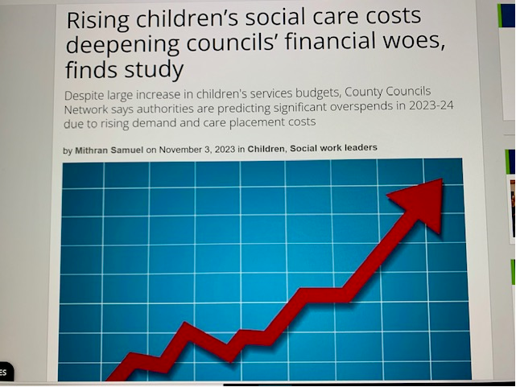
Context and Challenges…

Slide 5
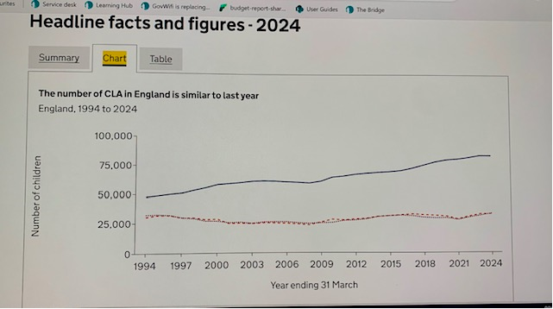
Context and Challenges…

Slide 6
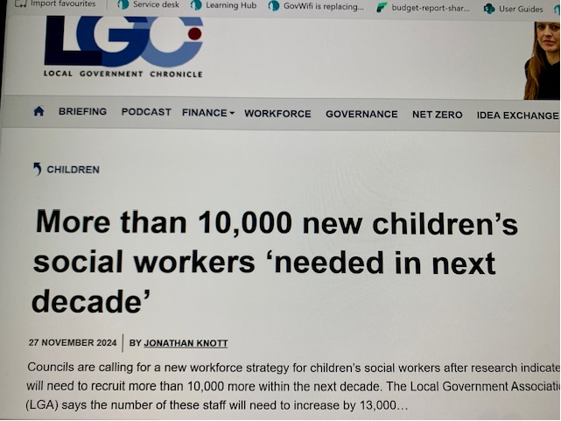
Context and Challenges…

Slide 7
Collaborative and Innovative approaches to reduce delay
Opportunities – build on good practice…
Trailblazer Pilot (Central London): introduced the Pre-Case Management Hearing meetings , DfE Sponsored Guided Learning Offer to all DFJ areas.
Investment in Prevention – Early Help / Family Hubs
Exploring Family Networks: FGC and Family Network Meetings
Diamond Project (Tower Hamlets): a pilot program that works with and supports birth parents at risk of having repeated pregnancies that lead to their children being removed from their care
Workforce – Learning Academies,
Workforce - Changes to agency terms and conditions

Slide 8
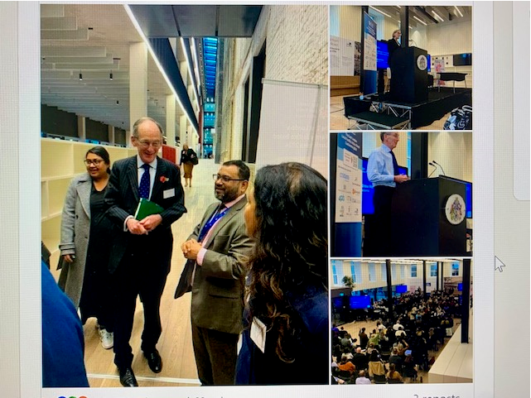
Collaborative and Innovative approaches to reduce delay
Opportunities – build on good practice…
All about positive relationships….

