Slide 1
EQUITY’S SUPPORT FOR COMMERCIAL BARGAINS
Commercial Court Seminar
8 May 2025
Mr Justice (Andrew) Henshaw

Slide 2
Equitable intervention?
Muschinski v Dodds (1985) 160 CLR 583, 615 per Deane J: “mix of judicial discretion, subjective views about which party ‘ought to win’ … and ‘formless void’ of individual moral opinion”
Cobbe v Yeoman’s Row Management [2008] UKHL 55 [46] per Lord Walker: “joker or wild card”

Slide 3
Anti-suit injunctions: ‘contractual’
Starting point: Transfield Shipping v Chiping Xinfa Huayu Alumina [2009] EWHC 3629 (Comm) §§ 51-52
Third party beneficiaries: Manta Penyez Shipping [2025] EWHC 353 (Comm)
D sues C’s affiliate:
Eurochem North-West-2 v Tecnimont [2023] EWCA Civ 688: ‘proxy war’
Renaissance Securities (Cyprus) v Chlodwig Enterprises [2024] EWHC 2843 (Comm) and on appeal [2025] EWCA Civ 359

Slide 4
Anti-suit injunctions: non-‘contractual’
D’s affiliate, colluding with D, sues C: Ingosstrakh Investments v BNP Paribas SA [2012] EWCA Civ 644
Shipowner sues sub-charterer: Clearlake Shipping Pte Ltd v Xiang Da Marine Pte Ltd [2019] EWHC 2284 (Comm)
Manta Penyez Shipping [2025] EWHC 353 (Comm) (again), referring to conditional benefit principle: Dell Emerging Markets (EMEA) Ltd v IB Maroc SA [2017] EWHC 2397 (Comm)

Slide 5
Conditional benefit principle
Aspen Underwriting Ltd v Credit Europe Bank (The “Atlantik Confidence”) [2018] EWCA Civ 2590:“If a party, X, acquires rights arising under a contract between A and B, X can only enforce those rights consistently with the terms of that contract ...”
Schiffahrtsgesellschaft Detlev von Appen GmbH v Voest Alpine Intertrading GmbH (The “Jay Bola”) [1997] 2 Lloyd's Rep 279
Wolverhampton City Council v London Gypsies and Travellers [2023] UKSC 47

Slide 6
Equitable compensation
Argos Pereira Espana SL v Athenian Marine Ltd, The ‘Frio Dolphin’, [2021] EWHC 554 (Comm)
The M/T Prestige v The Kingdom of Spain, The London Steam-ship Owners’ Mutual Insurance Association Limited v The Kingdom of Spain [2024] EWCA Civ 1536

Slide 7
Rectification
The detour:
Chartbrook v Persimmon Homes [2009] UKHL 38
Daventry District Council v Daventry & District Housing Ltd. [2011] EWCA Civ 1153
The return: FSHC Group Holdings Ltd. v Glas Trust Corporation Ltd [2019] EWCA Civ 1361

Slide 8
Mistake
Unilateral mistake in equity: Quoine Pte Ltd v B2C2 Ltd [2020] SGCA(I) 02
Constructive knowledge?
Centrovincial Estates Plc v Merchant Investors Assurance Co Ltd [1983] Com. L.R. 158
O.T. Africa Line Ltd v Vickers Plc [1996] 1 Lloyd’s Rep. 700, 703

Slide 9
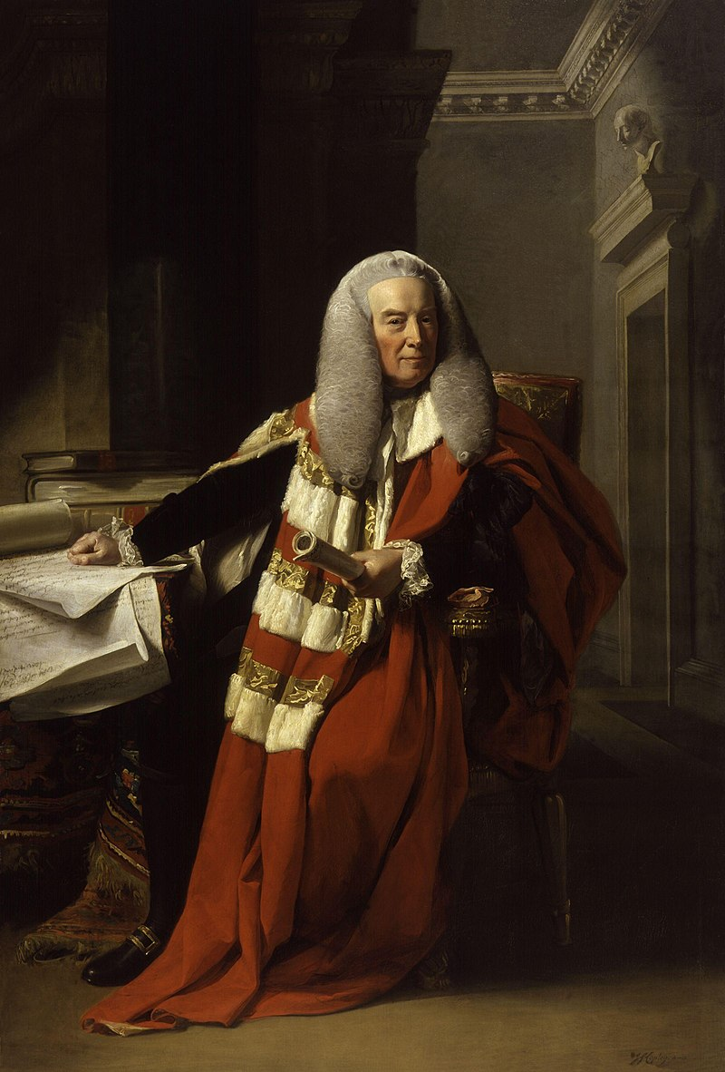
Coda
Alderson v Temple (1768) 4 Burr 2235, 2239 per Lord Mansfield
Vallejo v Wheeler (1774) 1 Cowp 143, 153 per Lord Mansfield

