Slide 1
Equitable Rescission:
Patarkatsishvili v Woodward-Fisher [2024] EWHC 2591 (Ch) aka “the moths case”
RUTH DEN BESTEN KC
ESSEX COURT CHAMBERS

Slide 2
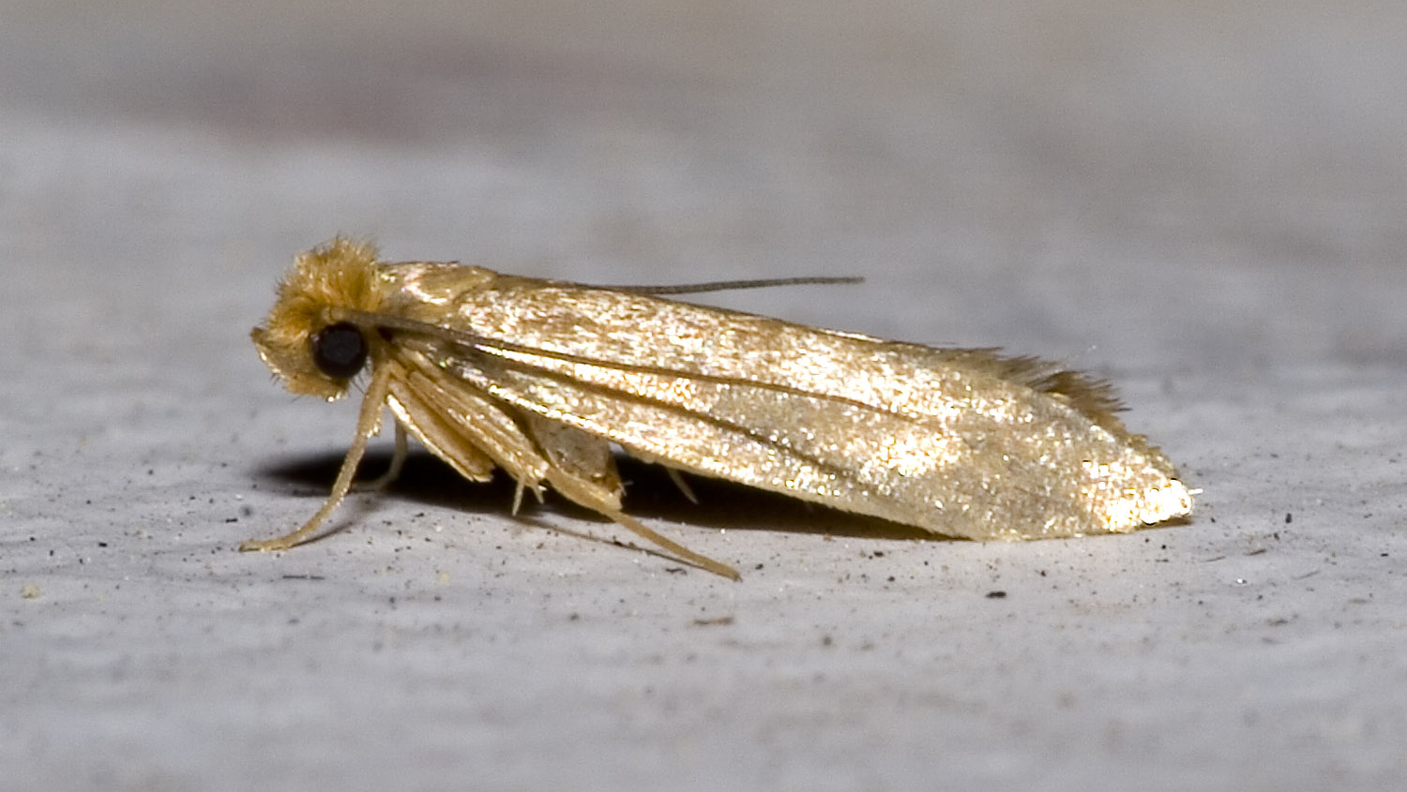

Slide 3
A basis for rescission was established because a contract for the sale of a sizeable property was found to have been entered into in reliance upon fraudulent misrepresentations as to:
A vermin infestation infecting the property;
The absence of reports concerning the vermin infestation;
The absence of latent defects in the property that were not apparent on inspection. ​

Slide 4


Slide 5
The rescission sought was equitable because the Cs required the court’s assistance to unwind the transaction, which had provided for the transfer of a registered property, so that a self-help common law recission would be inadequate.

Slide 6
In the case of fraud, where the right to rescind is established, the Court does not have a further discretion to refuse rescission.
“The issue is not, at a higher level, whether some other relief would be more practically just than granting rescission. The authorities establish that there may be bars to a claim for rescission, which include the ability of a claimant to make counter restitution, but if counter restitution can be given and there is no bar, there is no residual discretion that the Court can exercise on the basis that it appears fairer to leave a claimant to recover damages at law”.

Slide 7
Rescission will be unavailable where barred:
Laches,
Affirmation,
Restitutio in integrum/Counter-restitution

Slide 8
Restitutio in integrum is concerned with Cs’ ability to return the benefit taken under the contract, and not with Ds’ ability to return to the Claimant the precise benefit taken.
LJ Popplewell in School Facility Management Ltd v Governing Body of Christ the King College [2021] EWCA Civ 1053: “it is… the impossibility of counter restitution to the defendant that amounts to a defence to rescission, not difficulty in recovering the benefits conferred on the defendant”.

Slide 9
The Court fashioned a practical way forward: the grant of an equitable lien over the property in favour of Cs, securing their entitlement to repayment, whilst allowing WWF to regain title to the house and to sell it to raise the necessary funds.

Slide 10
A deal with too many moth holes (Tony Bingham, Building 2025, 3);
A misrepresentation of moths (Estates Gazette 2025, 2514, 47);
Of moths, millionaires and mansions (Law Society Gazette 2025, 122(10), 32)
Moths, mansions and misrepresentation: don't let the truth fly away (Taylor Wessing);
MOTH-ER OF ALL VERMIN (Stevens and Bolton).

