Slide 1

The Commercial Court Seminar 2026
The interface of public and private law
Chair: Lord Justice Singh
Panellists:
Justice Calver: “The Control of Contractual Discretions”
Professor Donal Nolan, Professor of Private law University of Oxford: “Tort and Public Law”
Marie Demetriou KC, Brick Court Chambers:
“Public Law Concepts in Sport Disputes”

Slide 2
The Commercial Court Seminar 2026
Justice Calver: “The Control of Contractual Discretions”

Slide 3
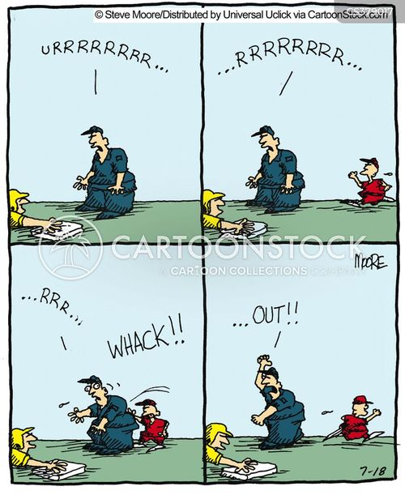
The control of contractual discretions
The Hon Mr Justice Calver​

Slide 4

Interfoto v Stilletto [1989] QB 433 at 439
“In many civil law systems, and perhaps in most legal systems outside the common law world, the law of obligations recognises and enforces an overriding principle that in making and carrying out contracts parties should act in good faith. This does not simply mean that they should not deceive each other, a principle which any legal system must recognise; its effect is perhaps most aptly conveyed by such metaphorical colloquialisms as ‘playing fair’, ‘coming clean’ or ‘putting one’s cards face upwards on the table.’ It is in essence a principle of fair open dealing … English law has, characteristically, committed itself to no such overriding principle but has developed piecemeal solutions in response to demonstrated problems of unfairness”.

Slide 5


Slide 6
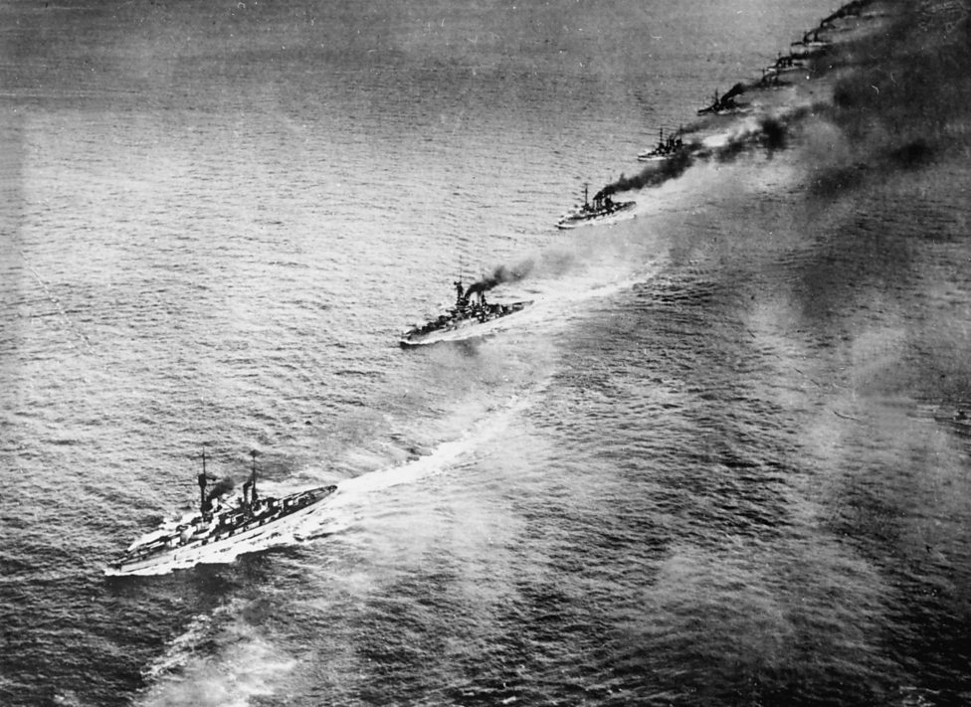
Discretion not to discharge at a port considered to be unsafe must be exercised fairly
Tillmanns v SS Knutsford Ltd [1908] 2 KB 385​

Slide 7
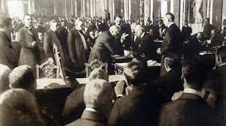
Weinberger v Inglis [1919] AC 606
“in order to vitiate the exercise of their powers it must be shown by evidence that their action was arbitrary and capricious”

Slide 8
Abu Dhabi National Tanker Co v Product Star Shipping (The Product Star) (No.2)
“for purposes of judicial review the court is concerned to judge whether a decision-making body has exceeded its powers, and in this context whether a particular decision is so perverse that no reasonable body, properly directing itself as to the applicable law, could have reached such a decision. But the exercise of judicial control of administrative action is an analogy which must be applied with caution to the assessment of whether a contractual discretion has been properly exercised. The essential question always is whether the relevant power has been abused. Where A and B contract with each other to confer a discretion on A, that does not render B subject to A's uninhibited whim. In my judgment, the authorities show that not only must the discretion be exercised honestly and in good faith, but, having regard to the provisions of the contract by which it is conferred, it must not be exercised arbitrarily, capriciously or unreasonably. That entails a proper consideration of the matter after making any necessary inquiries. To these principles, little is added by the concept of fairness: it does no more than describe the result achieved by their application”

Slide 9
Ludgate Insurance v Citibank [1998] EWHC 1144 (comm);
Paragon Finance v Nash [2002] 1 WLR 68
35. It is very well established that the circumstances in which a court will interfere with the exercise by a party to a contract of a contractual discretion given to it by another party are extremely limited. We were referred to Weinberger v Inglis [1919] AC 606; Dundee General Hospitals Board of Management v Walker [1952] 1 All ER 896; Docker v Hyams [1969] 1 Ll R 487; and Abu Dhabi National Tanker Company v Product Star Shipping Company Limited [1993] 1 Ll R 397 (“The Product Star”). These cases show that provided that the discretion is exercised honestly and in good faith for the purposes for which it was conferred, and provided also that it was a true exercise of discretion in the sense that it was not capricious or arbitrary or so outrageous in its defiance of reason that it can properly be categorised as perverse, the courts will not intervene.

Slide 10
Socimer International Bank v Standard Bank London [2008] Bus LR 1304
“It is plain … that a decision-maker’s discretion will be limited, as a matter of necessary implication, by concepts of honesty, good faith, and genuineness, and the need for the absence of arbitrariness, capriciousness, perversity and irrationality. The concern is that the discretion should not be abused. Reasonableness and unreasonableness are also concepts deployed in this context, but only in a sense analogous to Wednesbury unreasonableness, not in the sense in which that expression is used when speaking of the duty to take reasonable care, or when otherwise deploying entirely objective criteria: as for instance when there might be an implication of a term requiring the fixing of a reasonable price, or a reasonable time. In the latter class of case, the concept of reasonableness is intended to be entirely mutual and thus guided by objective criteria. … Laws LJ in the course of argument put the matter accurately, if I may respectfully agree, when he said that pursuant to the Wednesbury rationality test, the decision remains that of the decision maker, whereas on entirely objective criteria of reasonableness the decision-maker becomes the court itself... For the sake of convenience and clarity I will therefore use the expression rationality instead of Wednesbury-type reasonableness, and confine reasonableness to the situation where the arbiter on entirely objective criteria is the court itself.”

Slide 11
Hayes v Willoughby [2013] UKSC 17
“The concept of rationality has also in recent years played an increasingly significant role in the law relating to contractual discretions, where the law's object is also to limit the decision-maker to some relevant contractual purpose: see Ludgate Insurance Co Ltd v Citibank NA [1998] Lloyds Rep IR 221, para 35 and Socimer International Bank Ltd v Standard Bank Ltd [2008] Bus LR 1304, para 66. Rationality is not the same as reasonableness. Reasonableness is an external, objective standard applied to the outcome of a person's thoughts or intentions ... A test of rationality, by comparison, applies a minimum objective standard to the relevant person's mental processes. It imports a requirement of good faith, a requirement that there should be some logical connection between the evidence and the ostensible reasons for the decision, and (which will usually amount to the same thing) an absence of arbitrariness, of capriciousness or of reasoning so outrageous in its defiance of logic as to be perverse…”.

Slide 12

Reasonableness and rationality contrasted

Slide 13

Braganza v BP Shipping [2015] UKSC 17
The contractual duty to act rationally would be breached if (a) irrelevant matters were considered; or (b) relevant matters were excluded from account; or (c) the decision was so unreasonable that no reasonable decision-maker could have reached it.

Slide 14
Issues arising out of Braganza
Distinction between employment contract and commercial contract
Will the first limb of Wednesbury be applied to a discretion exercised under a “pure” commercial contract? Lehman Bros (International) v Exxonmobil Financial Services [2016] EWHC 2699 (Comm); MacDonald Hotels v Bank of Scotland [2025] EWHC 32
More intense scrutiny by the courts in the case of employment contracts
Nature of the decision makes a difference to the court’s intervention
Bonus payments: Gagliardi v Evolution Capital [2025] EWHC 3214; Clark v Nomura [2000] IRLR 766
Is the discretion open-ended?

Slide 15

Criticism of Braganza:
Michael Bridge KC LQR 2019 135 (April)
Lord Sales and Paul Davies in their analysis in LQR 2024 at 140: “Controlling contract discretions: Wednesbury reasonableness, good faith and proper purposes”:
Better approach to ask whether the discretion has been exercised for a proper purpose? Equitable Life v Hyman [2002] 1 AC 408; British Telecommunications Plc v Telefónica O2 UK Ltd [2014] UKSC 42
Pitt v Holt [2012] Ch 132

Slide 16
Is the relevant discretion a strong or weak discretion?
A weak discretion is usually a power to decide whether a state of facts exists or not, whereas a strong discretion is a power to decide what to do.
See Leggatt J in Brogden v Investec Bank [2014] EWHC 2785 at paras 95-97;
Mid Essex Hospital v Compass [2013] EWCA Civ 200 at para 83 (Jackson LJ)
TAQA Bratani Ltd and Others v Rockrose UKCS8 LLC [2020] EWHC 58 (Comm)
But see Equitas Insurance Ltd v Municipal Mutual Insurance Ltd [2020] Q.B. 418 at [113].
“In legal argument the term ‘discretion’ is used in several different senses. The term is sometimes used in a weak sense, simply to mean that the standards that a decision-maker must apply cannot be applied mechanically and demand the use of judgement. In Professor Dworkin’s example, a sergeant has a discretion in this sense if he is told to select his five most experienced men to take on patrol... [Another sense in which the term is used is to indicate that a person has final authority to make a decision which cannot be reviewed or reversed by someone else: for example, when we say that the umpire’s decision is final.]
The term ‘discretion’ is also used in a stronger sense to indicate that the authority which imposes duties on someone does not control their decision of a particular issue. Dworkin’s sergeant would have a discretion in this sense if he was simply told to select any five men of his choice to take on patrol. In a contractual context references to a ‘discretion’ are often to a discretion in the strong sense, meaning that the contract confers a duty or a power on one party to take a particular decision but does not expressly specify any standard which controls or constrains the decision.”

Slide 17

Unanswered questions post-Braganza

Slide 18


The consequence of a weak discretion

Slide 19
The Commercial Court Seminar 2026
Professor Donal Nolan, Professor of Private law University of Oxford: “Tort and Public Law”

Slide 20
Public Law Concepts in Sports Disputes
Marie Demetriou KC
Brick Court Chambers

Slide 21


Slide 22
No judicial review
R (Aga Khan) v Jockey Club [1993] 1 WLR 909
“(t)he Jockey Club is not in its origin, its history, its constitution or (least of all) its membership a public body”
“... the Jockey Club has power. But the mere fact of power, even over a substantial area of economic activity, is not enough”

Slide 23
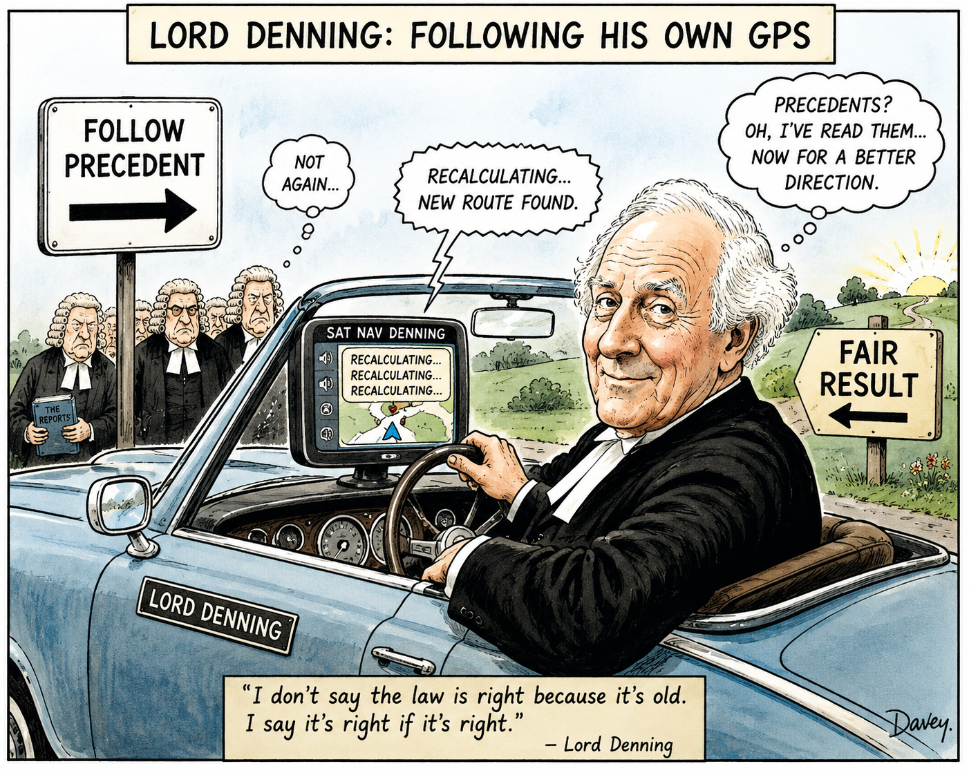

Slide 24
Bradley v Jockey Club
Per Richards J:
The function of the court… is to ensure that the primary decision-maker has operated within lawful limits. It is a review function, very similar to that of the court on a judicial review. Indeed… I would consider it surprising and unsatisfactory if a private law claim in relation to the decision of a domestic body required the court to take a materially different approach from a judicial review claim in relation to the decision of a public body. In each case the essential concern should be with the lawfulness of the decision taken: whether the procedure was fair, whether there was an error of law, whether any exercise of judgment fell within the limits open to the decision-maker…

Slide 25
Competition law
Chapter I prohibition CA98/ Art 101 TFEU
Chapter II prohibition/ Art 102 TFEU

Slide 26
Competition Law as a Regulatory Tool
Increase in competition law being used in sports disputes
Fuelled in part by Superleague
But sport different to other areas of commerce
Lends itself to shift from market effects to governance standards

Slide 27
European Superleague
Article 101(1) TFEU must be interpreted as meaning that the adoption and implementation, directly or through their member national football associations, of rules by associations which are responsible for football at world and European levels and which pursue in parallel various economic activities related to the organisation of competitions, making subject to their prior approval the setting up, on European Union territory, of a new interclub football competition by a third-party undertaking, and controlling the participation of professional football clubs and players in such a competition, on pain of sanctions, where there is no framework for those various powers providing for substantive criteria and detailed procedural rules suitable for ensuring that they are transparent, objective, non-discriminatory and proportionate, constitutes a decision by an association of undertakings having as its object the prevention of competition..

Slide 28
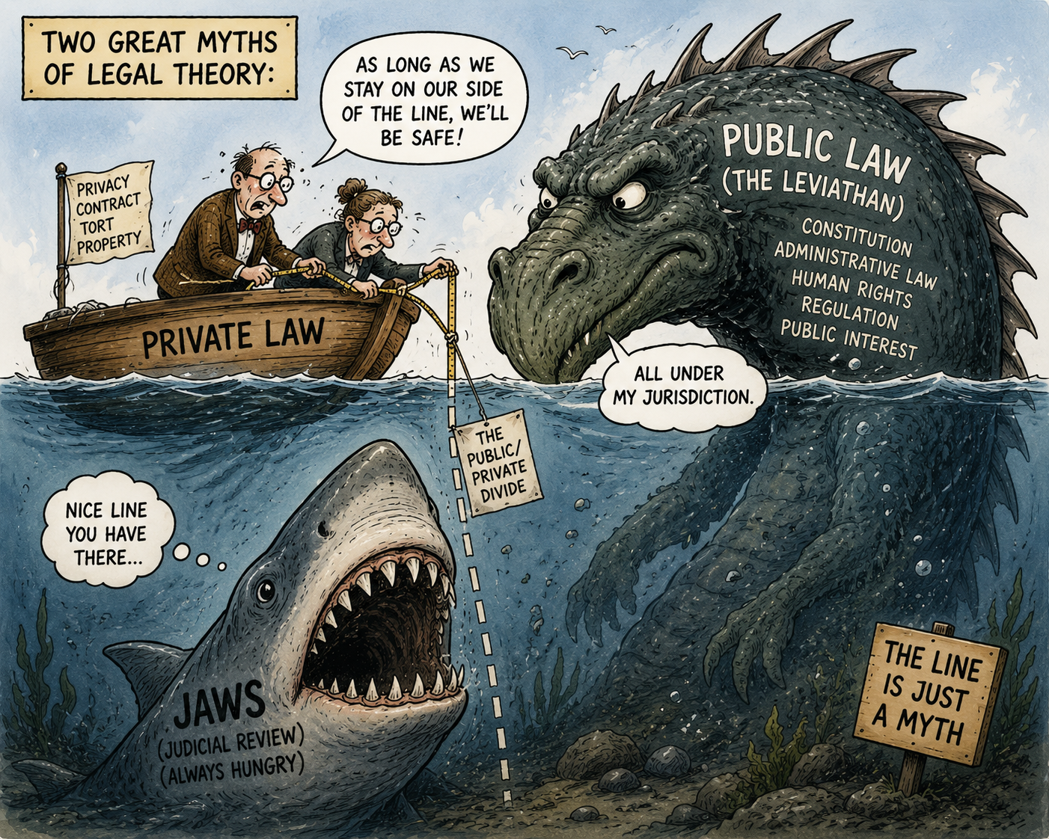

Slide 29
The Commercial Court Seminar 2026
The interface of public and private law

